Slide 1
Scientific Machine Learning for Modeling, Optimization, and Control of Dynamical Systems
Ján Drgoňa
Associate Professor Civil and Systems Engineering Department The Ralph O'Connor Sustainable Energy Institute (ROSEI)
Data Science and AI Institute (DSAI)

Slide 2
Course Syllabus
Week 1: Introduction to Scientific Machine Learning (SciML)
Week 2: Preliminaries and Introduction to differentiable programming
Week 3: Physics-informed neural networks (PINNs)
Week 4: Neural ordinary differential equations (NODEs)
Week 5: Learning to optimize (L2O)
Week 6: Optimal control preliminaries
Week 7: Learning to control (L2C)
Week 8: Neural differential and difference equations with constraints
Week 9: Feasibility restoration methods in L2O
Week 10: Safety filters for L2C
Week 11: Predict then optimize: decision focused learning
Week 12: Project evaluation with presentations
Week 13: Project evaluation with presentations

Slide 3
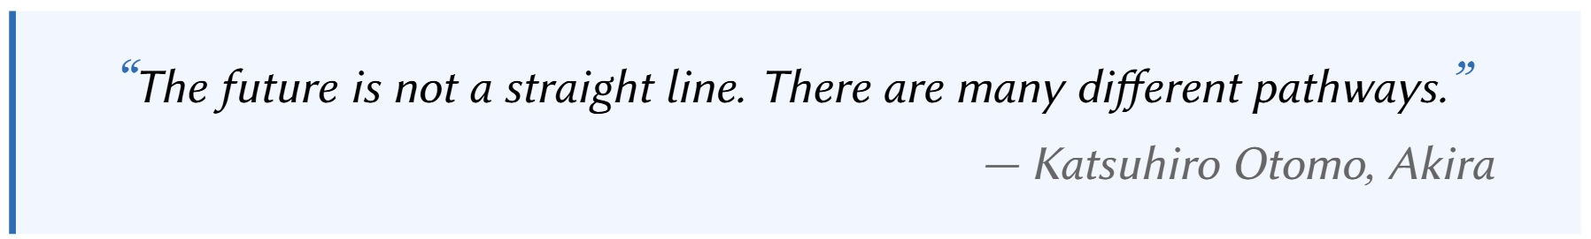

Neural Differential Equations (NDEs)
R. T. Q. Chen, et al., Neural Ordinary Differential Equations, 2019

Slide 4
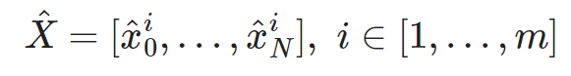
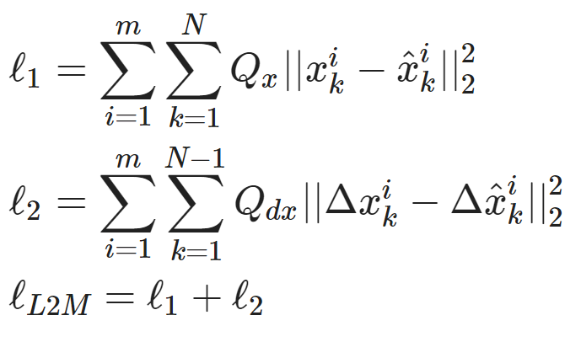
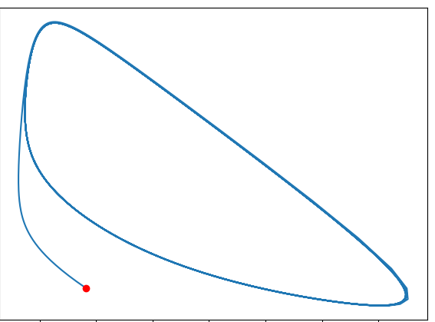
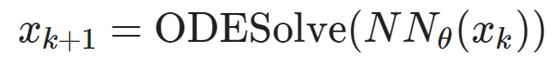
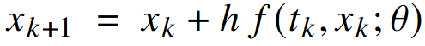
Components of Neural Differential Equations (NDEs)
Dataset: time-series of states, inputs, and disturbances tuples.
Architecture: differentiable ODE solver with neural network model.
Loss function: trajectory matching, regularizations, and constraints penalties.
Explicit Euler ODE solver:
https://github.com/pnnl/neuromancer/blob/master/examples/ODEs/Part_1_NODE.ipynb
R. T. Q. Chen, et al., Neural Ordinary Differential Equations, 2019

Slide 5
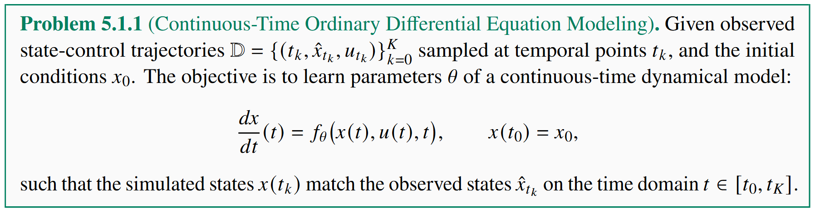
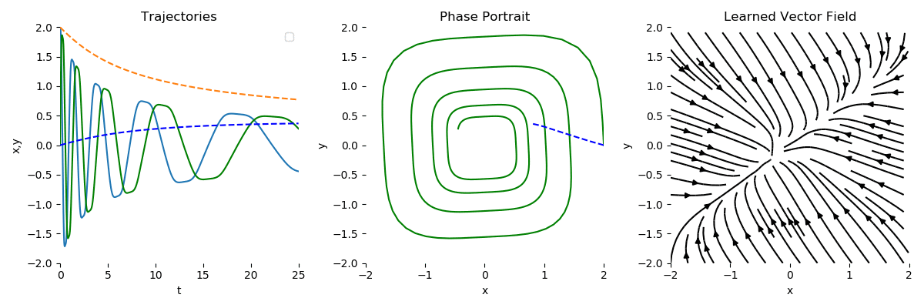
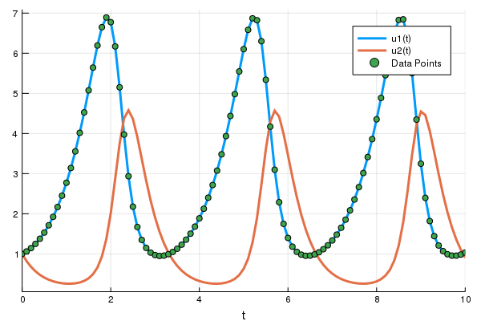
Data-Driven Neural Differential Equation Modeling Problem
R. T. Q. Chen, et al., Neural Ordinary Differential Equations, 2019
docs.sciml.ai/DiffEqDocs/stable/

Slide 6
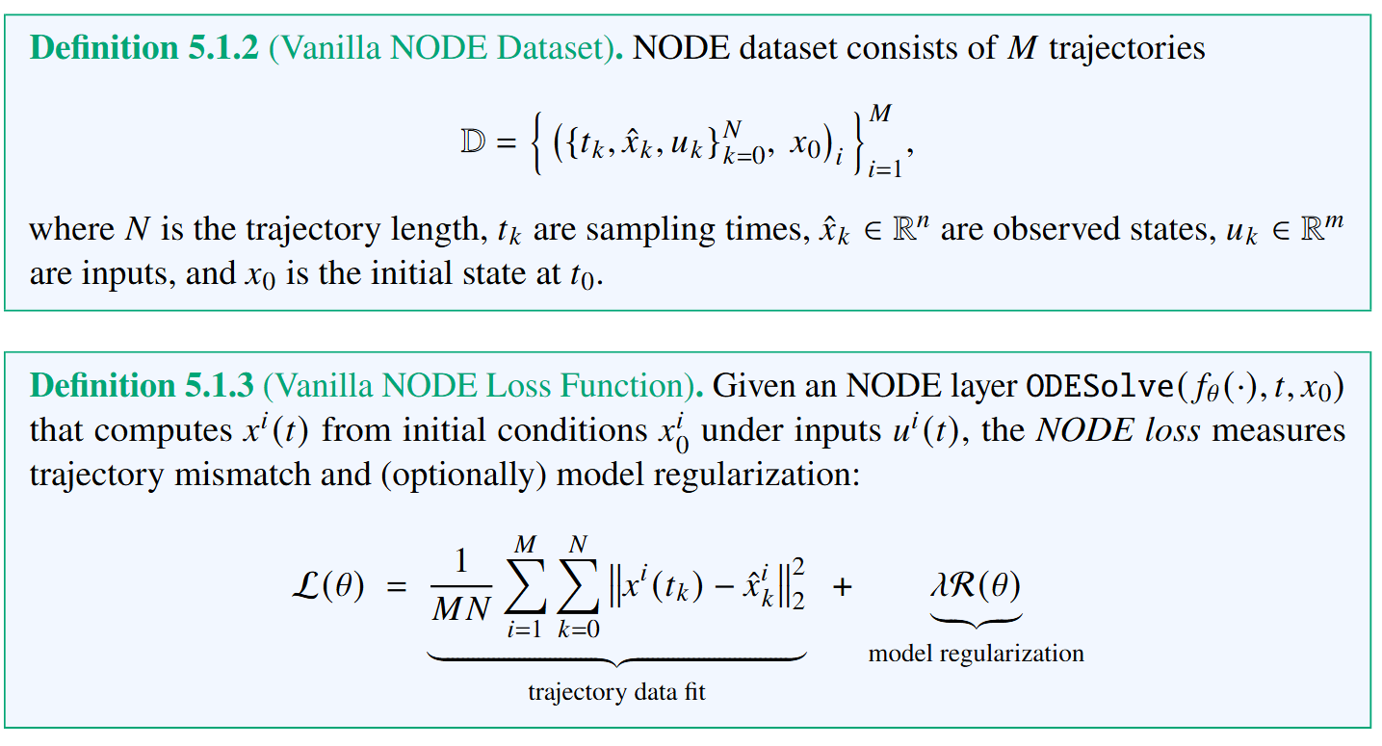
Neural ODE Dataset and Loss Function

Slide 7
Design Choices in NODE Architecture, Solvers, and Loss Functions
NODE Architectures
Black-box neural nets
White-box ODEs
Gray-box models
Network ODEs
Algebraic equations
Basis functions
Projections
Time-stepper solvers
Direct-time steppers (state space models)
Koopman operators
Explicit, implicit, semi-explicit ODE solvers
Fixed vs adaptive step size
Multistep solvers
Loss functions
Physics-informed
Stability regularized
Parameter regularizations
Sparse regression
Encoded-decoder reconstruction loss
Constraints penalties

Slide 8
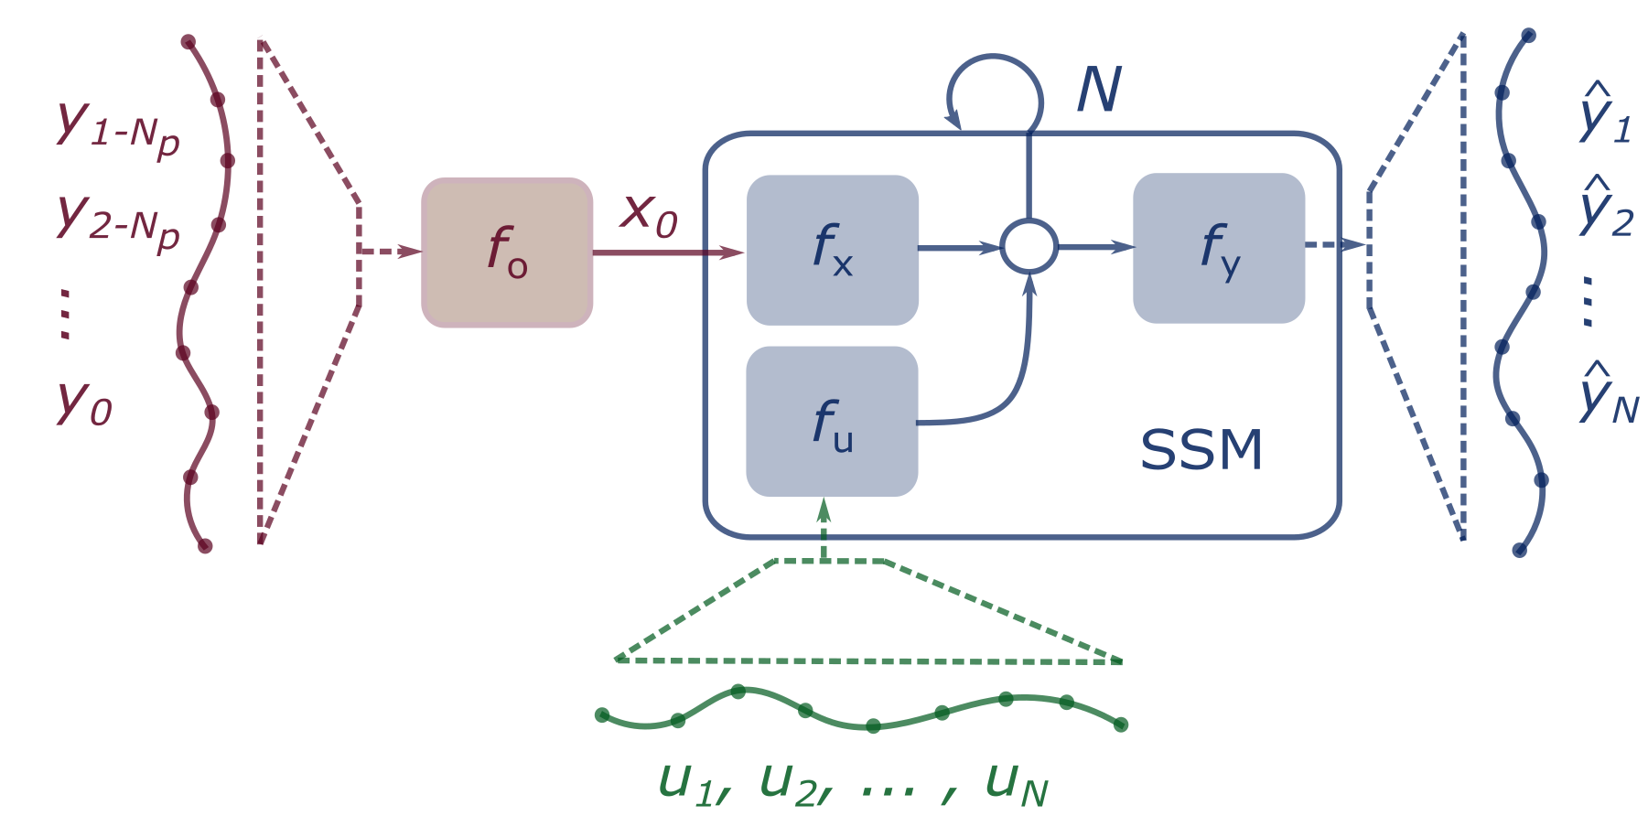
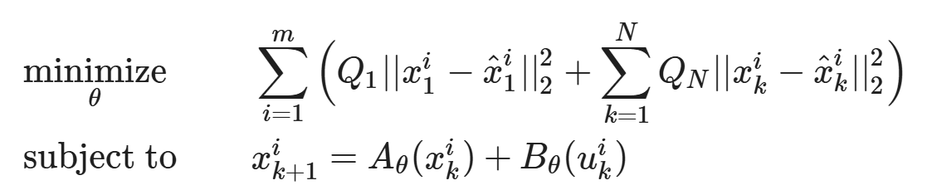
Neural State Space Models
Neural state space model (NSSM) is a generalization of classical discrete-time linear time invariant (LTI) state space model (SSM).
They represent direct time-stepper models without ODE solver layers.
https://colab.research.google.com/github/pnnl/neuromancer/blob/master/examples/ODEs/Part_5_nonauto_NSSM.ipynb

Slide 9
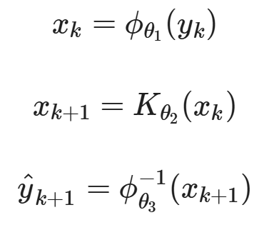
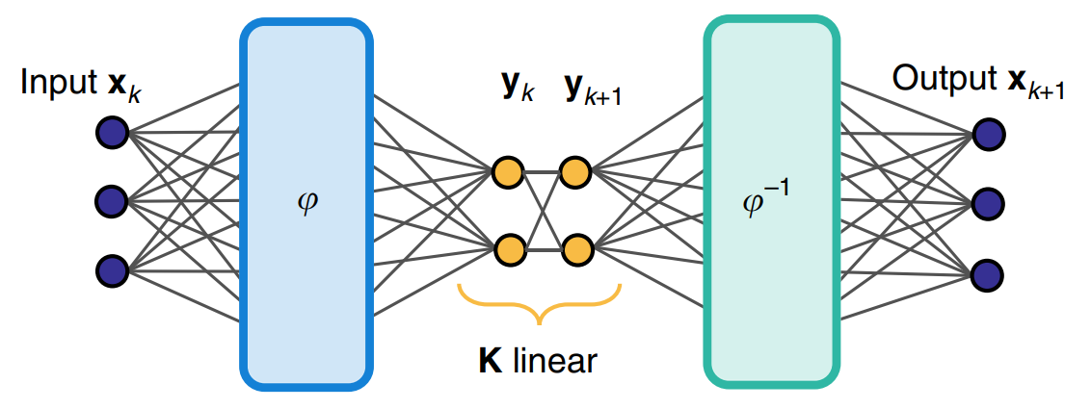
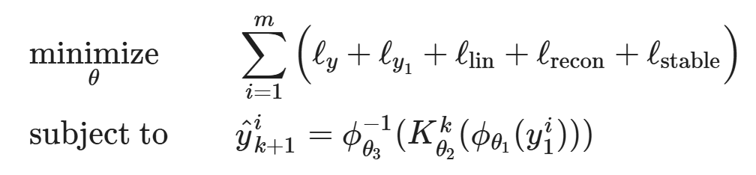
Stable Deep Koopman Operator
Encoder
Koopman Operator
Decoder
https://colab.research.google.com/github/pnnl/neuromancer/blob/master/examples/ODEs/Part_7_DeepKoopman.ipynb

Slide 10
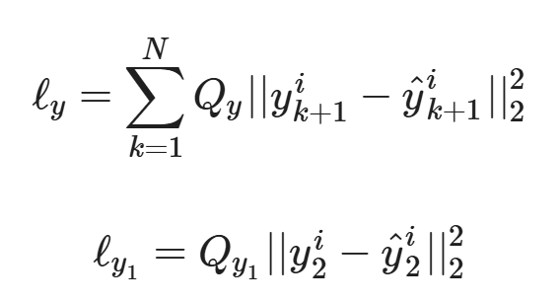
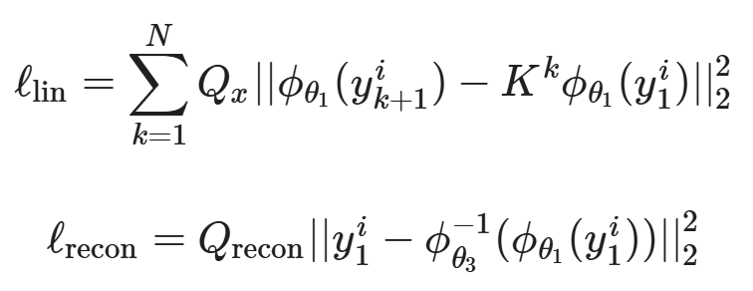
Stable Deep Koopman Operator
Output trajectory prediction loss, one step loss, latent trajectory prediction loss, reconstruction loss.
https://colab.research.google.com/github/pnnl/neuromancer/blob/master/examples/ODEs/Part_7_DeepKoopman.ipynb

Slide 11
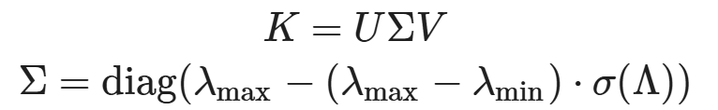
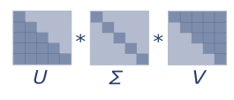
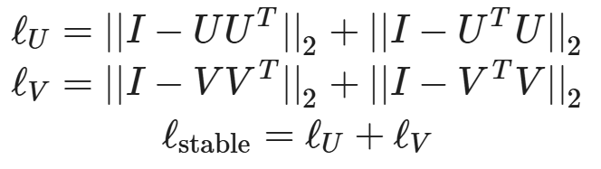
Stable Deep Koopman Operator
Singular Value Decomposition (SVD)-based matrix factorization and stabilization loss.
https://colab.research.google.com/github/pnnl/neuromancer/blob/master/examples/ODEs/Part_7_DeepKoopman.ipynb

Slide 12
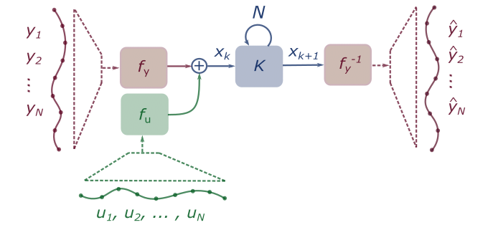
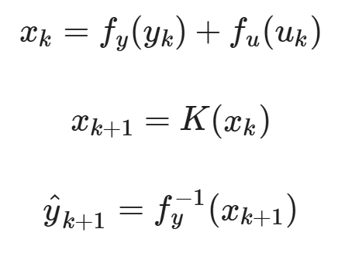
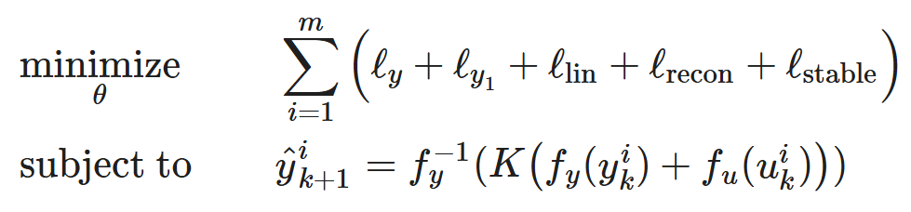
Deep Koopman Operator with Control Inputs
Encoder
Koopman Operator
Decoder
https://colab.research.google.com/github/pnnl/neuromancer/blob/master/examples/ODEs/Part_8_nonauto_DeepKoopman.ipynb

Slide 13
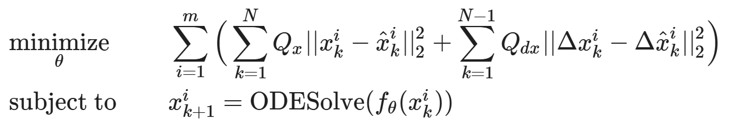
Black-box Neural Ordinary Differential Equations
https://colab.research.google.com/github/pnnl/neuromancer/blob/master/examples/ODEs/Part_1_NODE.ipynb

Slide 14
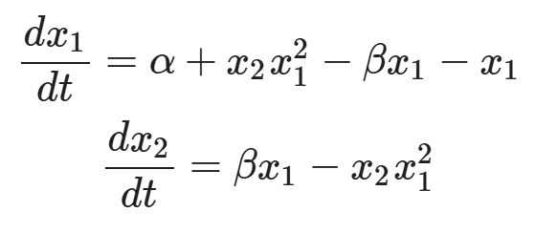
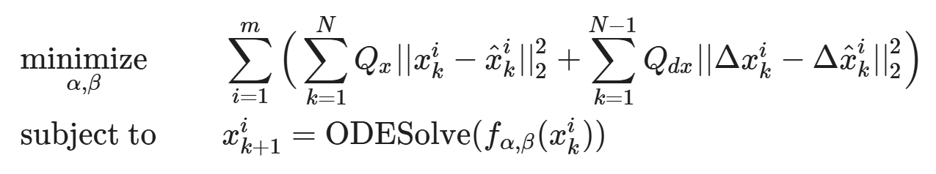
Parameter Estimation of White-box Ordinary Differential Equations
Known ODE with unknown parameters (Brusselator system)
https://colab.research.google.com/github/pnnl/neuromancer/blob/master/examples/ODEs/Part_2_param_estim_ODE.ipynb

Slide 15
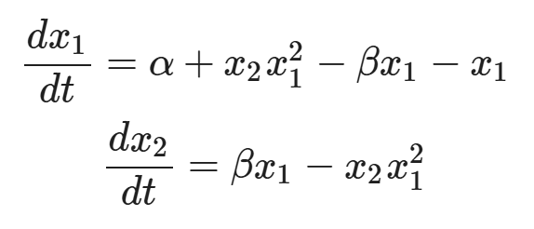
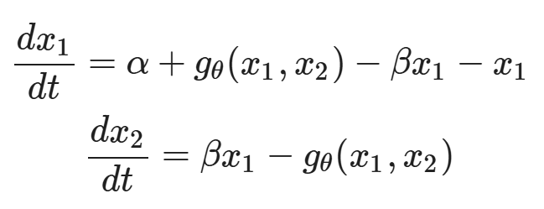
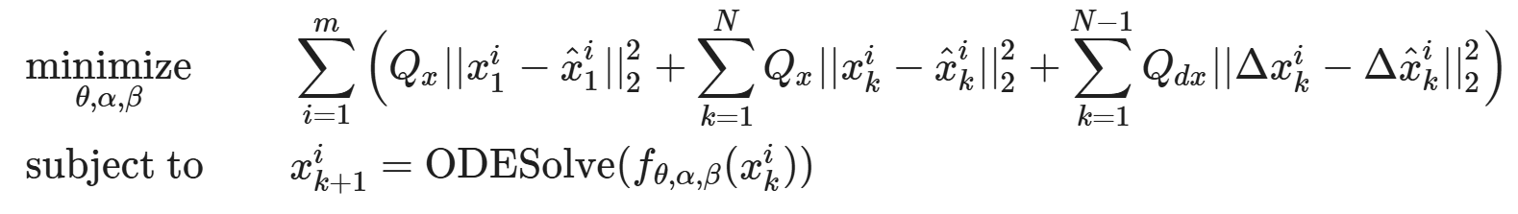
Universal Differential Equations (UDEs) – Gray-box NODEs
Ground truth ODE (Lotka Vloterra)
UDE model with neural components
https://colab.research.google.com/github/pnnl/neuromancer/blob/master/examples/ODEs/Part_3_UDE.ipynb

Slide 16
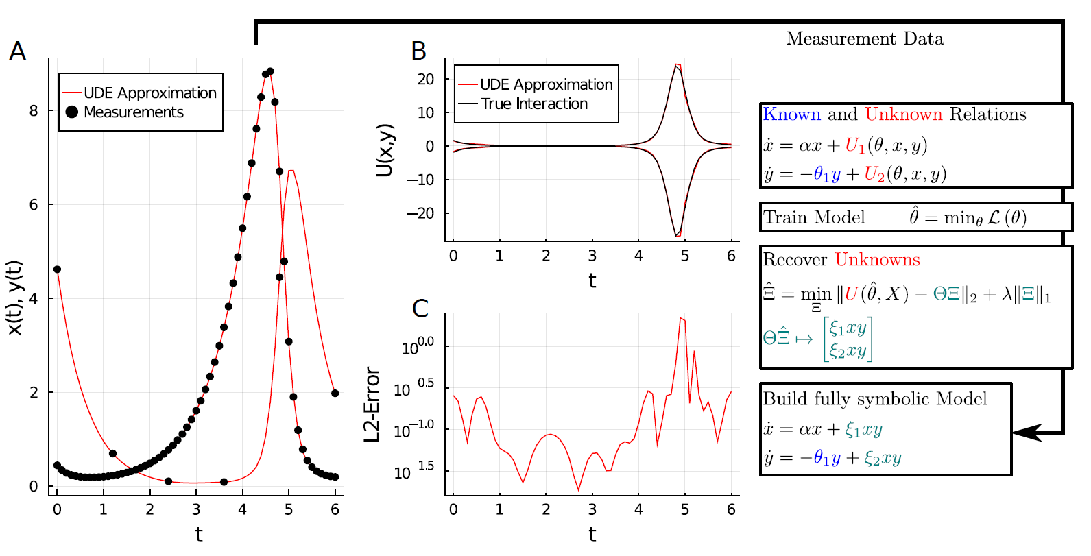
Universal Differential Equations (UDEs) – Gray-box NODEs
C. Rackauckas, et al., Universal Differential Equations for Scientific Machine Learning, arXiv:2001.04385, 2021

Slide 17
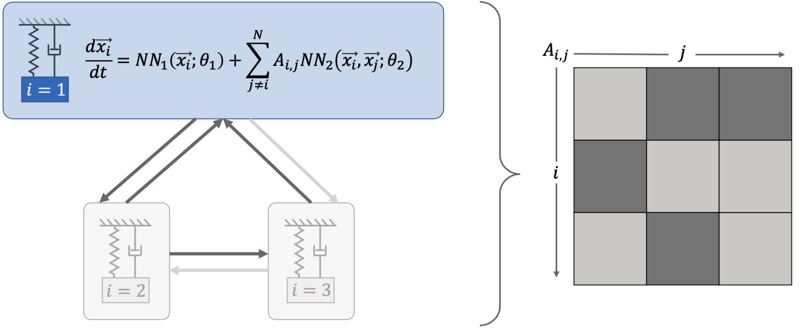
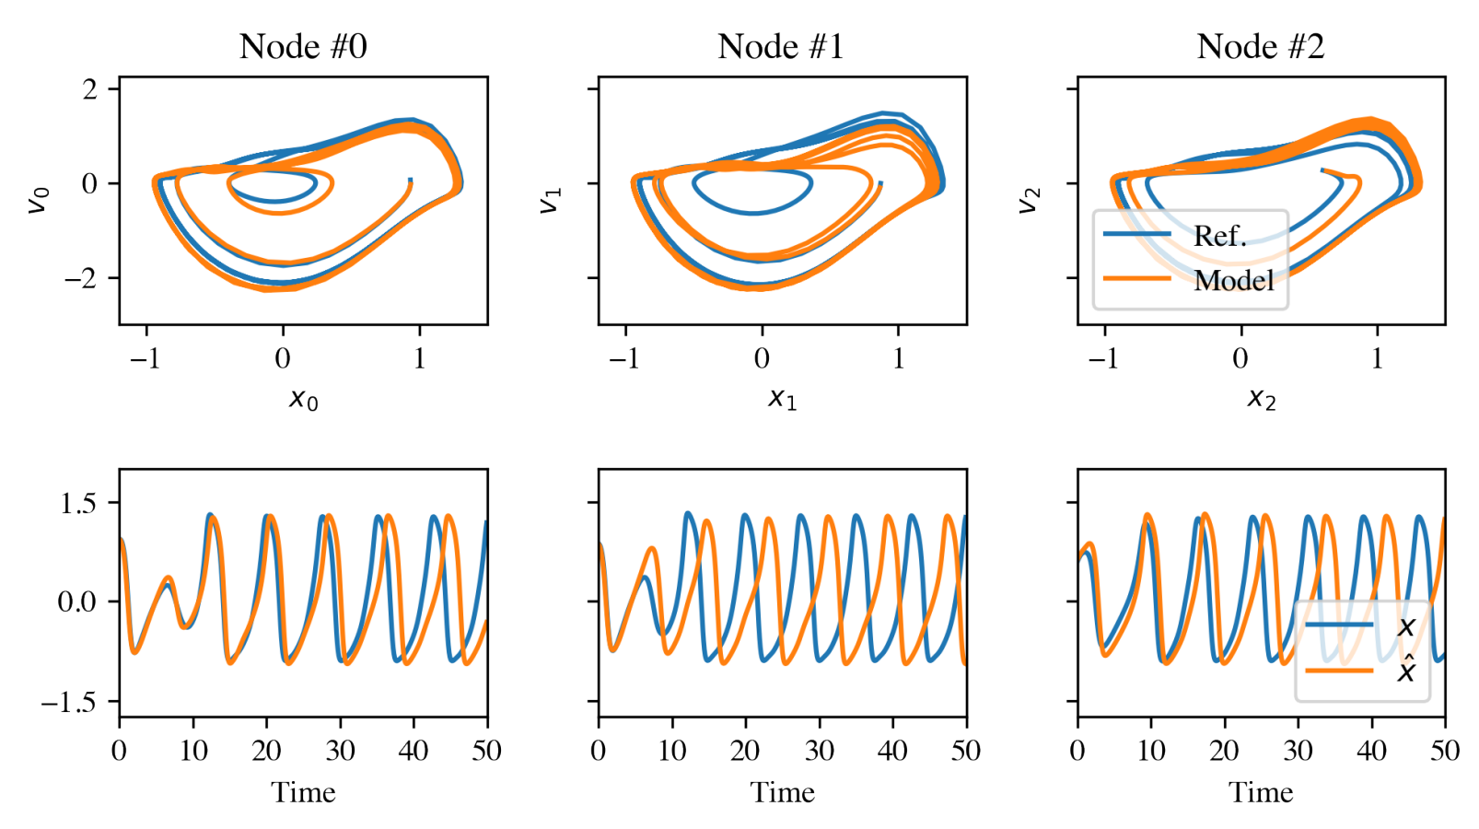
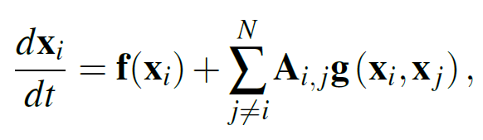
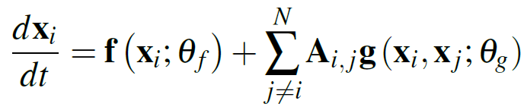
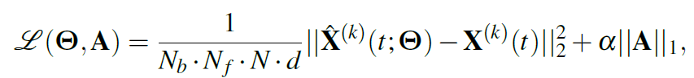
Networked Neural Ordinary Differential Equations
Network of unknown oscillators
Coupling adjacency
Ground truth network ODE system:
Generalization of learned dynamics on never-seen network topology.
Neural network ODE system:
Sparsity-promoting loss:
James Koch, Zhao Chen, Aaron Tuor, Jan Drgona, Draguna Vrabie, Structural Inference of Networked Dynamical Systems with Universal Differential Equations, Chaos: An interdisciplinary Journal of Nonlinear Science, doi.org/10.1063/5.0109093, 2023

Slide 18
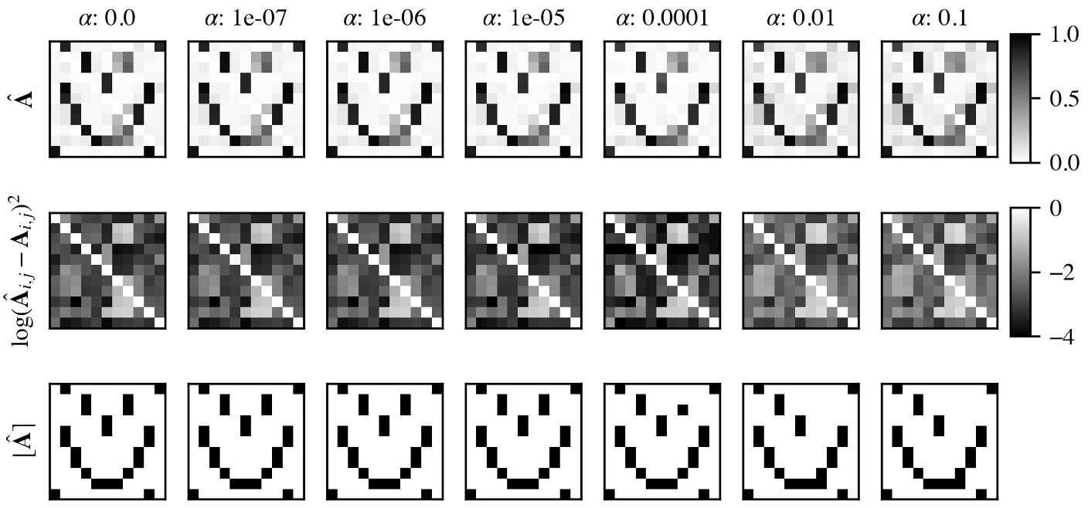
Networked Neural Ordinary Differential Equations
Learning adjacency matrix of the unknown network ODE system.
James Koch, Zhao Chen, Aaron Tuor, Jan Drgona, Draguna Vrabie, Structural Inference of Networked Dynamical Systems with Universal Differential Equations, Chaos: An interdisciplinary Journal of Nonlinear Science, doi.org/10.1063/5.0109093, 2023

Slide 19
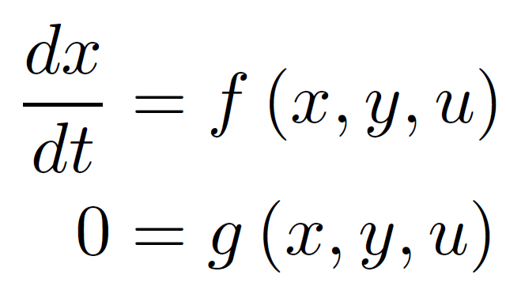
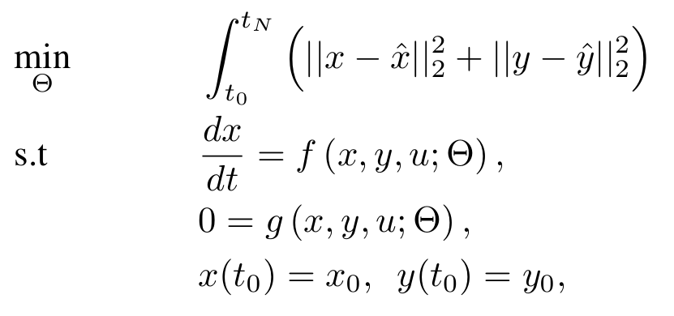
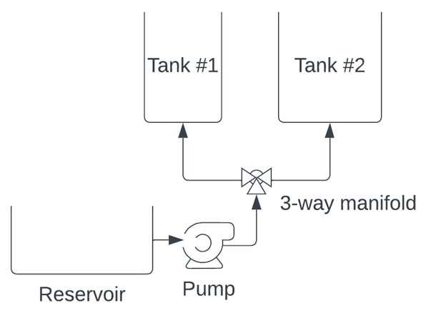
Neural Differential Algebraic Equations
Differential Algebraic Constraints
Problem Formulation
Assumptions: 𝑓 is continuous in 𝑡 and 𝑥, and 𝑓 is Lipschitz continuous in 𝑥 on some neighborhood of initial conditions, and g has nonsingular Jacobian, i.e., g is locally invertible.
Picard–Lindelöf theorem for index-1 DAE and gives sufficient conditions for unique solution of the initial value problem (IVP).
K. E. Brenan, S. L. Campbell, and L. R. Petzold, Numerical Solution of Initial-Value Problems in Differential-Algebraic Equations. SIAM, 1996.
J. Koch, M. Shapiro, H. Sharma, D. Vrabie, J. Drgona, Learning Neural Differential Algebraic Equations via Operator Splitting, arXiv:2403.12938, 2024.

Slide 20
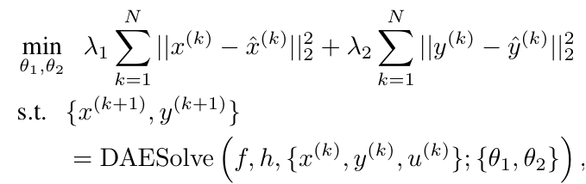
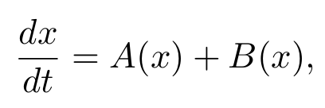
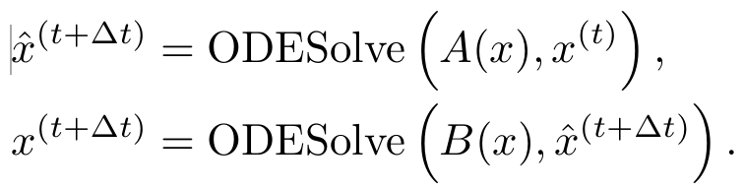
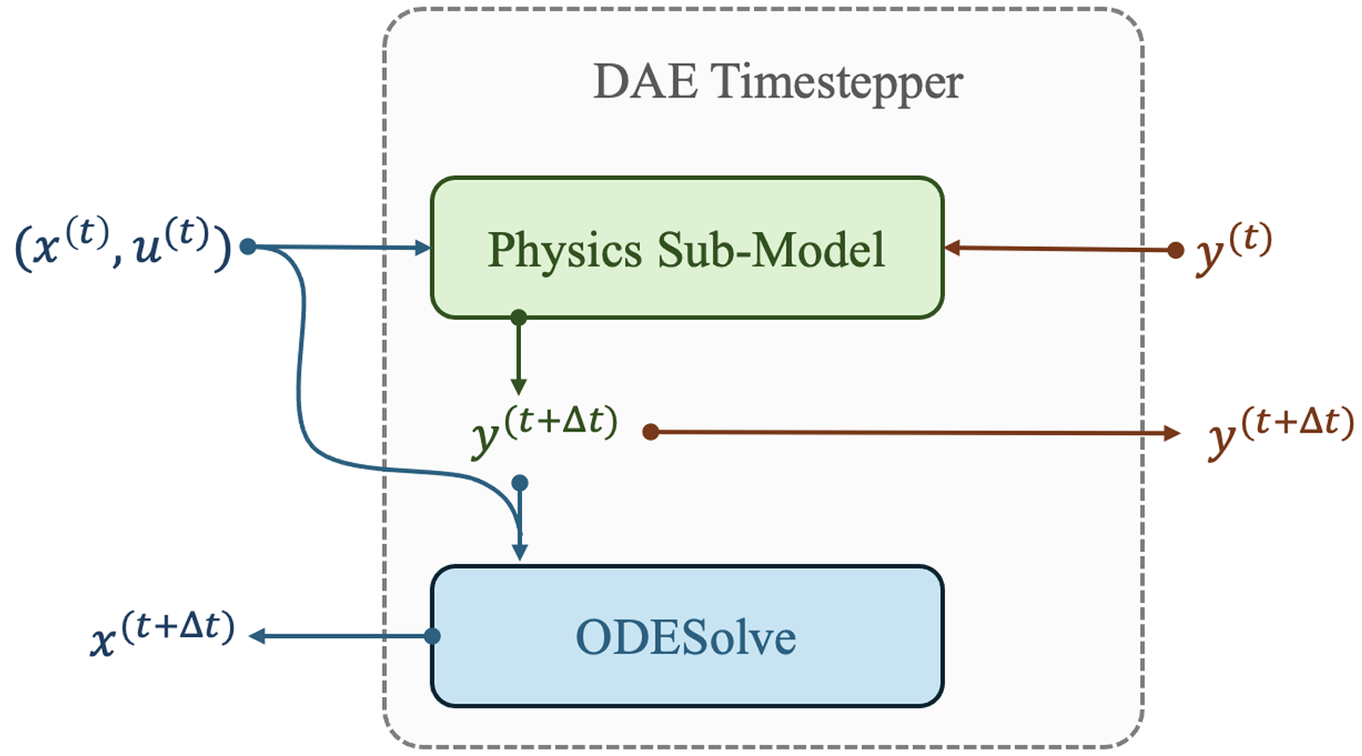
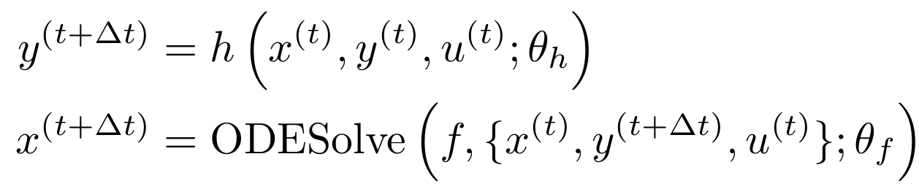
Learning Neural Differential Algebraic Equations via Operator Splitting
Our neural DAE time stepper architecture is inspired by operator splitting methods for ODEs:
Neural DAE learning problem:
Lie-Trotter splitting scheme for ODEs:
Operator splitting for DAEs:
Picard-Lindelof Theorem for index-1 DAEs.
J. Koch, M. Shapiro, H. Sharma, D. Vrabie, J. Drgona, Learning Neural Differential Algebraic Equations via Operator Splitting, arXiv:2403.12938, 2024.

Slide 21
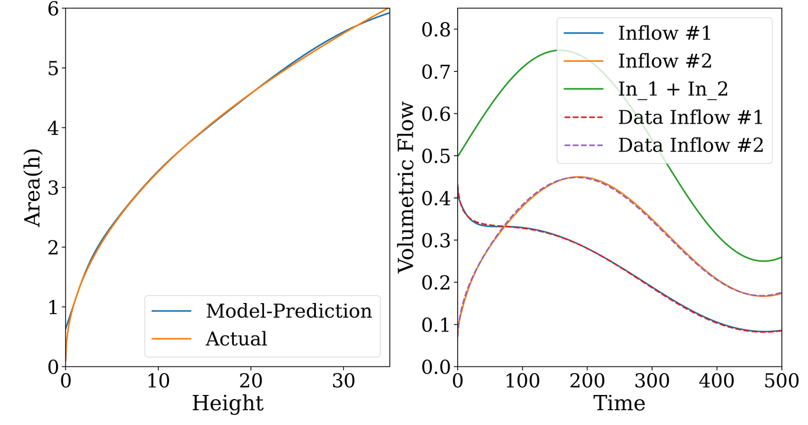
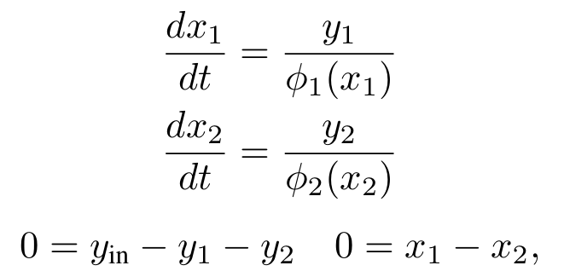
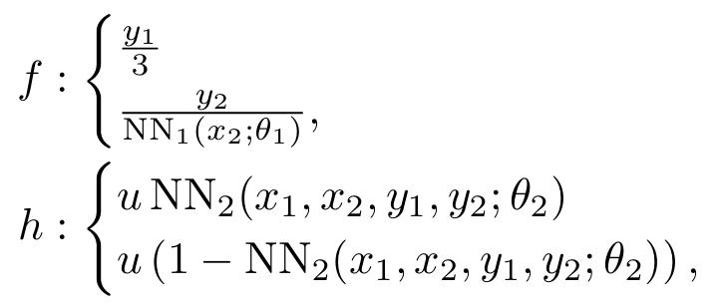
Learning Neural Differential Algebraic Equations via Operator Splitting
Case study: coupled tank modeling
DAE with unknown components:
Neural DAE:
Inverse modeling, robustness to noise and, out of distribution generalization.
https://drgona.github.io/NeuralDAEs/
https://colab.research.google.com/github/pnnl/neuromancer/blob/master/examples/DAEs/tank_dae_example.ipynb

Slide 22
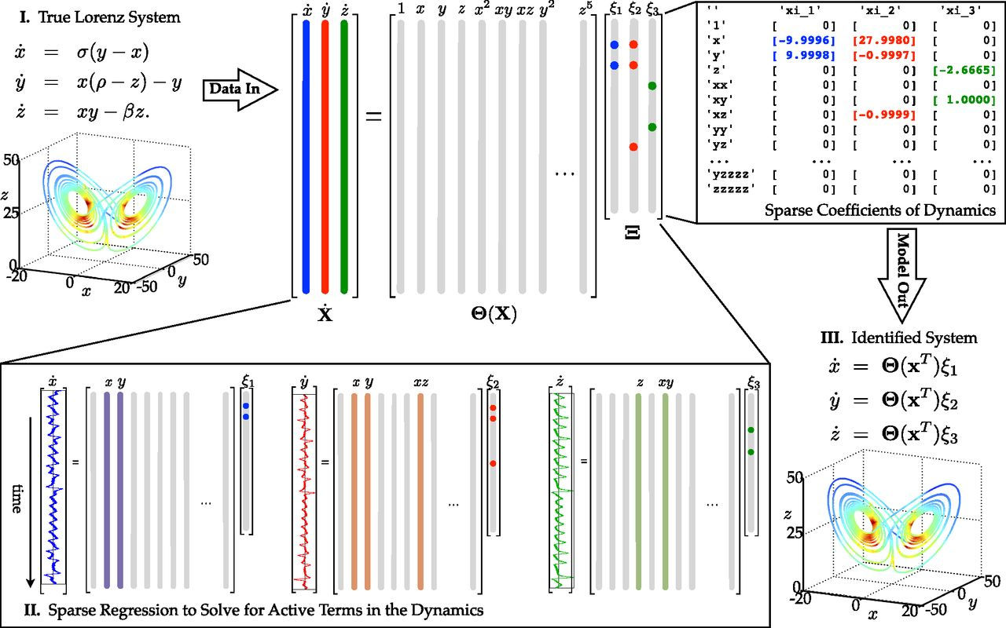
Sparse Identification of Nonlinear Dynamics (SINDy)
Steven L. Brunton, Joshua L. Proctor, and J. Nathan Kutz. “Discovering governing equations from data by sparse identification of nonlinear dynamical systems”, PNAS, 2016. https://github.com/dynamicslab/pysindy

Slide 23
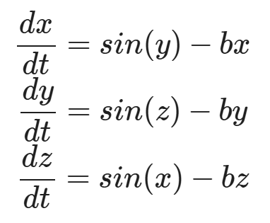
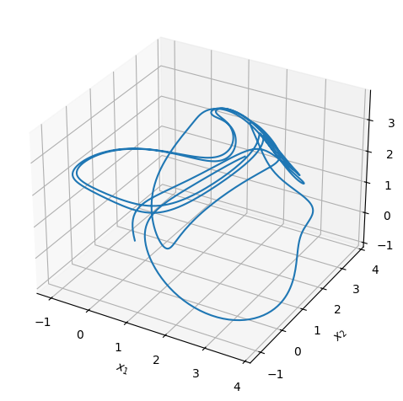



Learning Neural ODEs with SINDy Style Basis Functions
Ground truth system (Thomas Attractor)
Library of nonlinear basis functions:
Example: library of Fourier basis functions:
SINDY model:
https://colab.research.google.com/github/pnnl/neuromancer/blob/master/examples/ODEs/Part_9_SINDy.ipynb

Slide 24



Function Encoders with Neural ODEs
Right-hand side of the NODE represented as a linear combination of basis functions, with coefficients c computed via least squares, and ODE solution obtained by integration over sum of basis functions:
Tyler Ingebrand, Adam J. Thorpe, Ufuk Topcu, Zero-Shot Transfer of Neural ODEs, arXiv:2405.0895, 2024
https://colab.research.google.com/github/pnnl/neuromancer/blob/master/examples/function_encoder/Part_1_Intro_to_Function_Encoders.ipynb
https://colab.research.google.com/github/pnnl/neuromancer/blob/master/examples/function_encoder/Part_2_Function_Encoder_Neural_ODE.ipynb

Slide 25






NODE Open-Source Software Libraries
docs.sciml.ai/DiffEqDocs/stable/
docs.sciml.ai/DiffEqFlux/stable/
github.com/DiffEqML/torchdyn
Diffrax
github.com/rtqichen/torchdiffeq
docs.kidger.site/diffrax/
github.com/pnnl/neuromancer

Slide 26

NDEs in NeuroMANCER Scientific Machine Learning Library
NDE Examples
Neural Ordinary Differential Equations (NODEs)
Parameter estimation of physics-based ODEs
Universal Differential Equations (UDEs)
NODEs with control inputs
Sparse Identification of Nonlinear Dynamics (SINDy)
Function Encoders Neural ODEs
Neural Differential Algebraic Equations (NDAEs)
github.com/pnnl/neuromancer

Slide 27
References
C Rackauckas, Q Nie, DifferentialEquations.jl – A Performant and Feature-Rich Ecosystem for Solving Differential Equations in Julia, Journal of Open Research Software, 2017 https://docs.sciml.ai/DiffEqDocs/stable/
R. T. Q. Chen, et al., Neural Ordinary Differential Equations, NeurIPS, 2019
Michael Poli, et al., Graph Neural Ordinary Differential Equations, arXiv:1911.07532, 2019
Junteng Jia, Austin R Benson, Neural Jump Stochastic Differential Equations, NeurIPS, 2019
Will Grathwohl et al., FFJORD: Free-form Continuous Dynamics for Scalable Reversible Generative Models. ICLR, 2019.
Emilien Dupont, Arnaud Doucet, Yee Whye The, Augmented Neural ODEs, NeurIPS, 2019
Sam Greydanus, Misko Dzamba, Jason Yosinski, Hamiltonian Neural Networks, NeurIPS, 2019
Patrick Kidger, et al., Neural Controlled Differential Equations for Irregular Time Series, NeurIPS, 2020
Xuechen Li, et al., Scalable Gradients for Stochastic Differential Equations, PMLR, 2020
C. Rackauckas, et al., Universal Differential Equations for Scientific Machine Learning, 2021
Avik Pal, et al., Opening the Blackbox: Accelerating Neural Differential Equations by Regularizing Internal Solver Heuristics, ICML, 2021
Suyong Kim, et a., Stiff neural ordinary differential equations, Chaos: An Interdisciplinary Journal of Nonlinear Science, 2021
Yang Song, et al., Score-Based Generative Modeling through Stochastic Differential Equations, ICLR 2021.
Marin Biloš, et al., Neural Flows: Efficient Alternative to Neural ODEs, NeurIPS, 2021
Patrick Kidger, et al., Neural SDEs as Infinite-Dimensional GANs, ICML, 2021
Patrick Kidger, On Neural Differential Equations, arXiv:2202.02435, 2022
X. Kong, et al., Dynamic Parameter Estimation with Physics-based Neural Ordinary Differential Equations, IEEE PESGM, 2022
Stefano Massaroli, et al., Differentiable Multiple Shooting Layers, NeurIPS, 2021
E. Turan and J. Jäschke, Multiple Shooting for Training Neural Differential Equations on Time Series, IEEE Control Systems Letters, 2022
James Koch et al., Structural inference of networked dynamical systems with universal differential equations, Chaos: An Interdisciplinary Journal of Nonlinear Science, 2023
Christian Legaard, et al., Constructing neural network based models for simulating dynamical systems, ACM Computing Surveys, 2023
Facundo Sapienza, et al., Differentiable Programming for Differential Equations: A Review, arXiv:2406.09699v1, 2024
James Koch, et al., Learning Neural Differential Algebraic Equations via Operator Splitting, CDC, 2025
https://implicit-layers-tutorial.org/neural_odes/
https://ayandas.me/blogs/2020-03-20-neural-ode
https://iclr2020deepdiffeq.rice.edu/
https://github.com/dynamicslab/pysindy

Slide 28
Homework
First version of your project technical report: Final project aims to be 4 to 6 page long pdf document including references and figures, written using Latex.
By next week write introduction and motivation, related work, detailed problem formulation, sketch of the methodology, add 2-3 milestones with quantifiable metrics, if you already have include preliminary results.

Slide 29
Week 11: Project Presentations and Evaluation
Projects cover 70% of the course grade!
Project proposal 20% - week 5
Project progress report 10% - week 9
Project final report 20% - week 12
Project presentation 20% - week 12-13
Project format.
Project technical report: 4 to 6 page long pdf document including references and figures.
Project presentation: ppt or pdf slides, 15 min time slot per student in week 11.
Admissible topics.
Application of selected SciML methods to problems inspired by real-world applications
e.g., L2O for large scale optimization of energy systems.
Development of new methods tackling some of the open challenges in SciML
e.g., novel way of utilizing PINNs in differentiable control for PDEs.
New theory supporting selected SciML methodology
e.g., convergence analysis of feasibility restoration layers in L2O.

